Slide 1

STANLEY COLLEGE OF ENGINEERING AND TECHNOLGY FOR WOMEN (AUTONOMOUS)
Abids. Hyderabad – 500 001
(Affiliated to Osmania University & Approved by AICTE)
(All eligible UGC courses are accredited by NBA & NAAC with ‘A’ Grade)
Department of Computer Science and Engineering
Academic Year: 2025-2026
Internship Presentation
On
Recipe Card Website
Mrs. Shaheda Begum
Assistant Professor
Department of CSE
PRESENTED BY
Chilpoori Srivani
160622733080

Slide 2
INTERNSHIP - II DETAILS
Course Code: SPW611 CS Credits: 1 Evaluation: CIE - 50 Marks
Title: Recipe Card Website.
Name of the Student: Chilpoori Srivani
Roll Number: 160622733080
Batch / Section: 2024 – 2025 / B
Name of the Organization:VoultsOf Codes
Duration of Internship: From 01st May 2025 to 1st June 2025
Mode (Onsite / Online / Hybrid) : Online
Faculty Coordinator / Supervisor: Mrs. Shaheda Begum

Slide 3
Contents
Abstract
Problem Statement
Background and Literature Review
Planning and Design of Work
Implementation and Execution
Testing / Validation
Results and Analysis
Challenges and Solutions
Conclusion and Future Scope
References

Slide 4
Abstract
This internship project involved designing and developing a simple and interactive Recipe Card Website using HTML, CSS, and JavaScript. The website provides features such as viewing recipe details, toggling ingredient lists, using a cooking timer, and printing recipes. The focus was on creating a responsive and user-friendly interface through DOM manipulation, CSS styling, and JavaScript event handling. The internship at VaultofCodes helped me gain practical experience in front-end development, debugging, version control, and responsive design, effectively connecting theoretical knowledge with real-world application.
Throughout the internship at VaultofCodes, I gained hands-on experience in web development workflows, version control using GitHub, debugging, UI/UX design principles, and cross-device testing. The project strengthened my technical skills, problem-solving ability, and understanding of industrial development practices. Overall, this internship successfully bridged the gap between theoretical learning and real-world application by enabling the creation of a fully functional and interactive recipe management interface.

Slide 5
1. Problem Statement
Many existing recipe websites are cluttered, non-interactive, and not optimized for quick access, making it difficult for users to follow or manage recipes efficiently. There is a need for a simple, clean, and responsive web interface that allows users to view recipes easily with essential interactive features. This project aims to develop a user-friendly Recipe Card Website that provides an organized layout, smooth navigation, and interactive functions using HTML, CSS, and JavaScript.Additionally, users often face difficulties in toggling recipe steps, managing ingredient lists, or tracking cooking time due to poorly structured designs. A lack of responsiveness across devices also affects usability and overall user experience. Therefore, the project focuses on creating a minimalist yet functional interface that enhances accessibility, engagement, and ease of use for all types of users.

Slide 6
2. Background and Literature Review
In recent years, recipe websites have become a major digital medium for sharing cooking information, but many platforms contain cluttered layouts, unnecessary ads, and poor responsiveness.
Users often struggle to find recipe details quickly due to unorganized interfaces and lack of interactive features.
Modern front-end technologies like HTML5, CSS3, and JavaScript allow developers to create clean, responsive, and user-friendly web applications.
This project focuses on building a simple, attractive, and interactive Recipe Card Website that prioritizes clarity, usability, and device compatibility.
The design follows modern UI/UX principles to ensure smooth navigation, readability, and an overall improved user experience.

Slide 7
Table 2.1: Summary of reviewed literature on Intrusion Detection Systems
S. No. | Author(s) & Year | Focus Area | Methodology / Technology Used | Key Findings / Contribution
1 | Ethan Marcotte (2011) | Graph-based intrusion detection | GNN-based IDS (GNN-IDS) | Proposed a GNN-based IDS achieving high accuracy in modeling relational dependencies between network entities.
2 | Don Norman (2013) | User Experience Design | UX principles, interaction design | Highlighted the importance of simplicity and intuitive interfaces, influencing modern UI/UX practices.
3 | Jon Duckett (2014) | Front-end Web Structure | HTML5 + CSS3 semantic structuring | HTML5 + CSS3 semantic structuringEmphasized semantic HTML for cleaner layouts and better browser compatibility.
4 | Douglas Crockford (2018) | JavaScript Best Practices | JS functions, event handling | Improved understanding of code structuring, DOM operations, and secure JS programming.
5 | W3C Consortium (2020) | Web Standards & Accessibility | W3C HTML/CSS standards | Set global guidelines for accessible, device-friendly, and standards-compliant web design.
6 | MDN Web Docs (2021) | DOM Manipulation Techniques | DOM API, event listeners | Provided foundational techniques for dynamic web content updates and interactivity.

Slide 8
Table 2.1: Summary of reviewed literature on Intrusion Detection Systems
S. No. | Author(s) & Year | Focus Area | Methodology / Technology Used | Key Findings / Contribution
7 | Sharma et al. (2022) | Moderan UI/Ux | Responsive design frameworks | Demonstrated the impact of usability and layout optimization on user engagement.
8 | Gupta & Rao (2022) | Interactive Web Components | JavaScript ES6 features | Showed how ES6 functions improve speed, interactivity, and modular coding.
9 | Mozilla Foundation (2023) | Web Performance Optimization | Browser rendering engines | Proposed a deep learning-based IDS using stacked autoencoders that improved detection accuracy and reduced false positives compared to classical ML models.
10 | FreeCodeCamp (2024)) | Practical Front-End Projects | HTML/CSS/JS hands-on practice | Demonstrated how project-based learning strengthens practical front-end development skills

Slide 9
3. Planning and Design of Work
The work began by understanding the project requirements and identifying the essential features needed for the Recipe Card Website.
Suitable web technologies like HTML5, CSS3, and JavaScript were selected after reviewing modern front-end development practices.
A simple and clean layout was planned through wireframes to ensure the website would be responsive and user-friendly across all devices.The development process was organized into steps such as structure creation, styling, adding interactive functions, integrating all modules, and refining the design.
The system was built using a client-side architecture, combining HTML for structure, CSS for layout, and JavaScript for interactivity, ensuring smooth functionality and easy maintenance.

Slide 10
System Architecture
1.The Recipe Card Website follows a client-side layered architecture that ensures smooth functioning and easy maintenance. The system is divided into four main modules:
2. Input Module: Accepts user actions like Show Ingredients, Start Timer, and Print Recipe.
3. Pre-processing Module: Uses JavaScript to handle logic such as toggling ingredients, managing timers, and updating progress dynamically through DOM manipulation.Detection Module: Performs object detection using the YOLOv8 algorithm and draws bounding boxes around detected boxes.
4. Counting Module: Designed using HTML and CSS for page structure, styling, and responsive layout to ensure a better user experience across devices.
5. Output Module: Displays the final recipe card with dynamic updates and interactive features for the user.

Slide 11
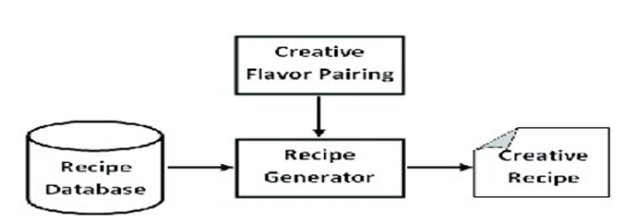
Figure 3.1: System Architecture Diagram

Slide 12
4. Implementation and Execution
The webpage structure was created using HTML5, including sections for the recipe title, image, ingredients, instructions, and interactive buttons.
CSS3 was applied to design the layout, style the elements, and ensure the website was fully responsive across mobile, tablet, and desktop screens.
JavaScript functions were implemented to handle interactivity such as toggling ingredient lists, starting and stopping the cooking timer, and enabling the print option.
Each module (HTML, CSS, and JavaScript) was integrated step-by-step and tested continuously to ensure smooth communication through DOM manipulation.
The website was executed and tested in different web browsers using Developer Tools to check responsiveness, fix errors, and ensure consistent performance across all devices.

Slide 13
4.1 Pseudocode
body {
font-family: Arial, sans-serif;
background: #f4f4f4; padding: 20px;}
recipe-card {
background: #fff;
padding: 20px;
max-width: 500px;
margin: auto; border-radius:
10px; box-shadow: 0 0 10px rgba(0,0,0,0.1);
}
recipe-card img {
width: 100%;
border-radius: 10px;
transition: transform 0.3s ease;}.
recipe-card img:hover {
transform: scale(1.05);}
button { padding: 10px; margin: 10px 0;
background-color: #ff6347;
color: white;
border: none; cursor: pointer; transition: background 0.3s ease; }
button:hover { background-color: #e5533d;}
.hidden { display: none;}.step { transition: all 0.5s ease-in;}
#progressBar { width: 100%; height: 10px; background: #ddd; margin-top: 20px;}
#progress { width: 0%; height: 100%; background: #4caf50; transition: width 0.5s ease;}
@media (max-width: 600px) { .recipe-card { padding: 10px; }
button { width: 100%;
}}

Slide 14
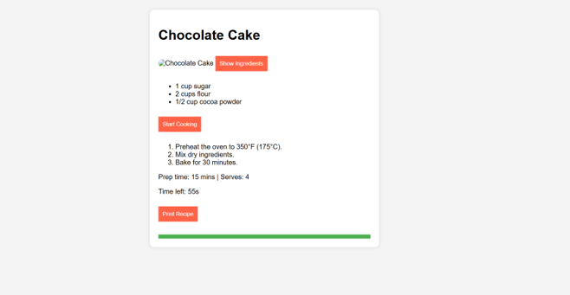
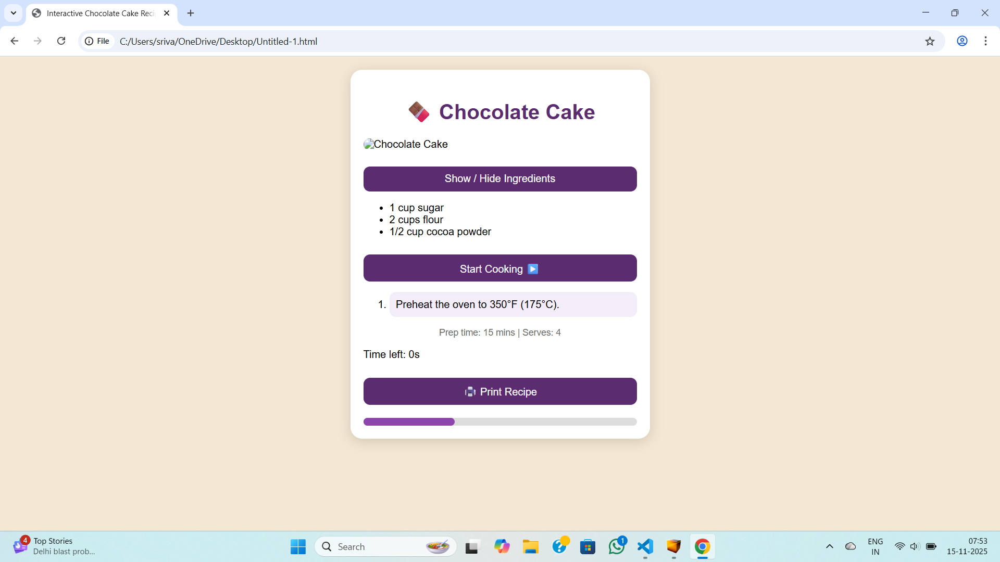

Slide 15
5. Testing / Validation
The website's core features—ingredient toggle, timer function, and print option—were individually tested to ensure each JavaScript function worked correctly.
Responsiveness testing was performed using multiple screen sizes (mobile, tablet, and desktop) to confirm the layout adjusted smoothly with the help of CSS Flexbox and media queries.
Cross-browser testing was carried out on Chrome, Firefox, and Edge to verify consistent performance, styling, and interactivity.
HTML and CSS code were validated using W3C validators to detect structural or styling issues, ensuring the website followed standard web guidelines.
Debugging was done using browser Developer Tools to fix alignment issues, script errors, and improve the overall visual layout, resulting in a stable and fully functional system.

Slide 16
6. Results and Analysis
The Recipe Card Website successfully displayed recipe information in a clean and organized layout, making it easy for users to follow the steps and view ingredients.
All interactive features, including ingredient toggling, cooking timer, and print functionality, worked smoothly through efficient JavaScript event handling.
The responsive design performed well across different device sizes, with Flexbox ensuring proper alignment, spacing, and readability on mobile, tablet, and desktop screens.
Browser testing confirmed that the website maintained consistent performance and styling across Chrome, Firefox, and Edge, showing strong compatibility with modern web standards.
Overall analysis showed improved user experience due to reduced clutter, faster loading, and intuitive navigation, proving the effectiveness of the chosen front-end technologies and design approach.

Slide 17
7. Challenges and Solutions
.
Faced responsiveness issues on small screens; fixed using Flexbox and media queries.
JavaScript button functions clashed; solved by adding separate event listeners.
Print layout was distorted; corrected using a dedicated print CSS style.
Styling looked different in various browsers; adjusted CSS for cross-browser compatibility.
Debugging took more time than expected; resolved by testing each feature step-by-step using DevTools.
Initial color themes and spacing did not look visually appealing.improved by refining CSS design and adding subtle animations.
Timer functionality had minor delays during early testing.

Slide 18
8. Conclusion and Future Scope
The project successfully demonstrated how HTML, CSS, and JavaScript can be used to create a simple, responsive, and interactive Recipe Card Website.
The internship strengthened practical skills in front-end development, debugging, responsive design, and version control with GitHub.
The website achieved its goal of providing a clean layout, smooth navigation, and useful interactive features like ingredient toggling, timer, and print functionality.
Future improvements can include adding a backend system to store recipes, user accounts, and personalized recipe collections.
Additional features such as search filters, ratings, recipe uploads, and API integration for nutritional data can make the website more dynamic and user-friendly.

Slide 19
References
Ethan Marcotte, Responsive Web Design, A Book Apart, 2011. This work introduced fluid layouts and media queries, forming the foundation of modern responsive web development.
Douglas Crockford, JavaScript: The Good Parts, O’Reilly Media, 2008. Provides essential JavaScript best practices that help improve code quality and performance.
Jon Duckett, HTML and CSS: Design and Build Websites, John Wiley & Sons, 2014. A beginner-friendly guide that explains how to structure and style web pages effectively.
MDN Web Docs, HTML5, CSS3, and JavaScript Documentation, Mozilla Foundation. Offers comprehensive explanations and examples for implementing modern web features.
W3Schools, HTML, CSS, and JavaScript Tutorials, W3Schools Online Learning Platform. Interactive tutorials that simplify learning through examples and hands-on practice.

Slide 20
References
6. W3C, HTML5 and CSS3 Standards and Best Practices, World Wide Web Consortium, 2020. Defines the standard rules and guidelines developers must follow for compliant and accessible websites.
7. FreeCodeCamp, Responsive Web Design Certification, FreeCodeCamp.org, 2024. Covers practical exercises that strengthen layout, styling, and responsive design skills.
8. Google Chrome Developers, Chrome DevTools Documentation, Google Developers. Provides debugging tools that assist developers in optimizing website design and performance.
9. Visual Studio Code Documentation, User Guide & Extensions, Microsoft Corporation, 2024. Explains features and extensions that enhance productivity during web development.
10. Mozilla Developer Network, CSS Flexbox and Media Queries Guide, Mozilla Foundation, 2023. Detailed guidance on building adaptive and flexible layouts suitable for all devices.

Slide 21
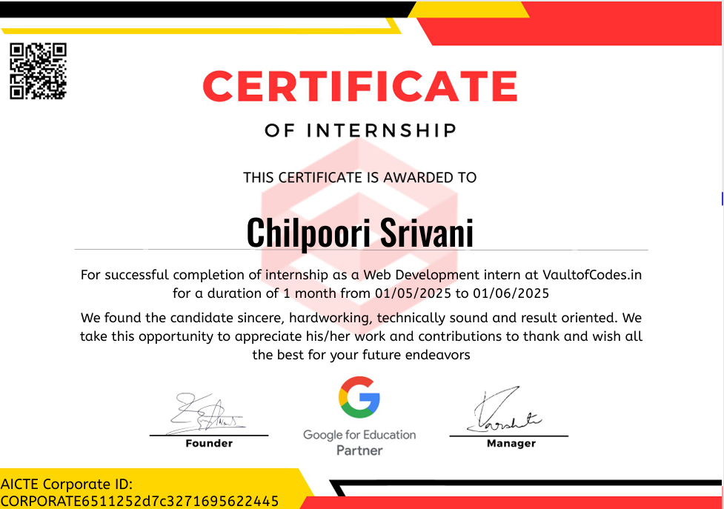
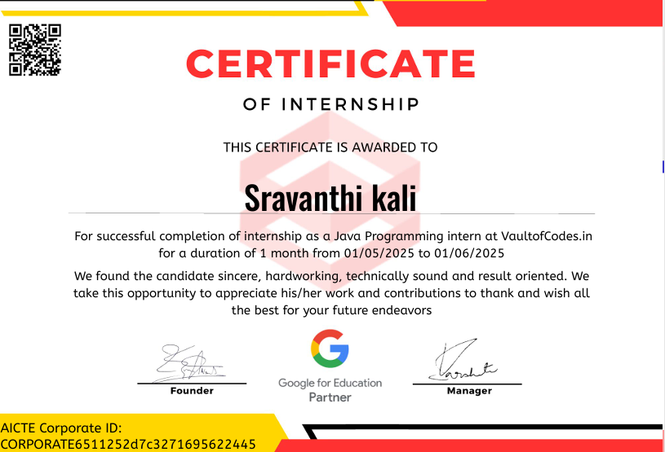
Internship Completion Certificate

